Slide 1
Hate Speech Detection Using Transformers
Presented By :Rakshit Grover
Specialization: NLP
Batch Code: LISUM35

Slide 2
Outline
Project Overview
Data Collection
Data Preprocessing
Feature Engineering
Exploratory Data Analysis
Model Building
Model Evaluation
Conclusion & Future Work

Slide 3
Project Overview
Problem Statement:
Hate speech refers to any form of verbal, written, or behavioral communication that attacks individuals or groups based on identity factors such as religion, ethnicity, race, or gender.
Objective: Build a hate speech detection model using machine learning techniques on Twitter data.
Approach:
Sentiment classification using labeled datasets.
Model training on Twitter data to classify tweets as hate speech or free speech.

Slide 4
Data Collection
The dataset for this project, sourced from Kaggle, consists of Twitter data used for research in hate speech detection. The dataset contains 31,962 observations and three features. The text is categorized into two classes: hate speech and free speech. It is important to note that the dataset includes content that may be considered offensive, including racist, sexist, or homophobic language.
Total number of observations | 31962
Total number of files | 1
Total number of features | 3
Base format of the file | csv
Size of the data | 2.95 MB

Slide 5
Data Preprocessing
Text Cleaning:Convert to lowercase, remove punctuation, URLs, Twitter handles, and special characters.
Operations:Tokenization, removing stopwords, stemming.
Visualization:Word Cloud of common words in hate speech and free speech tweets.

Slide 6
Feature Engineering
Bag of Words (BoW):Converts text into fixed-length vectors by counting word frequencies.
TF-IDF:Enhances BoW by weighting word frequencies.
Word2Vec:Captures semantic meaning by training on word co-occurrence patterns.
Data Balancing:Implemented SMOTE for handling class imbalance.

Slide 7
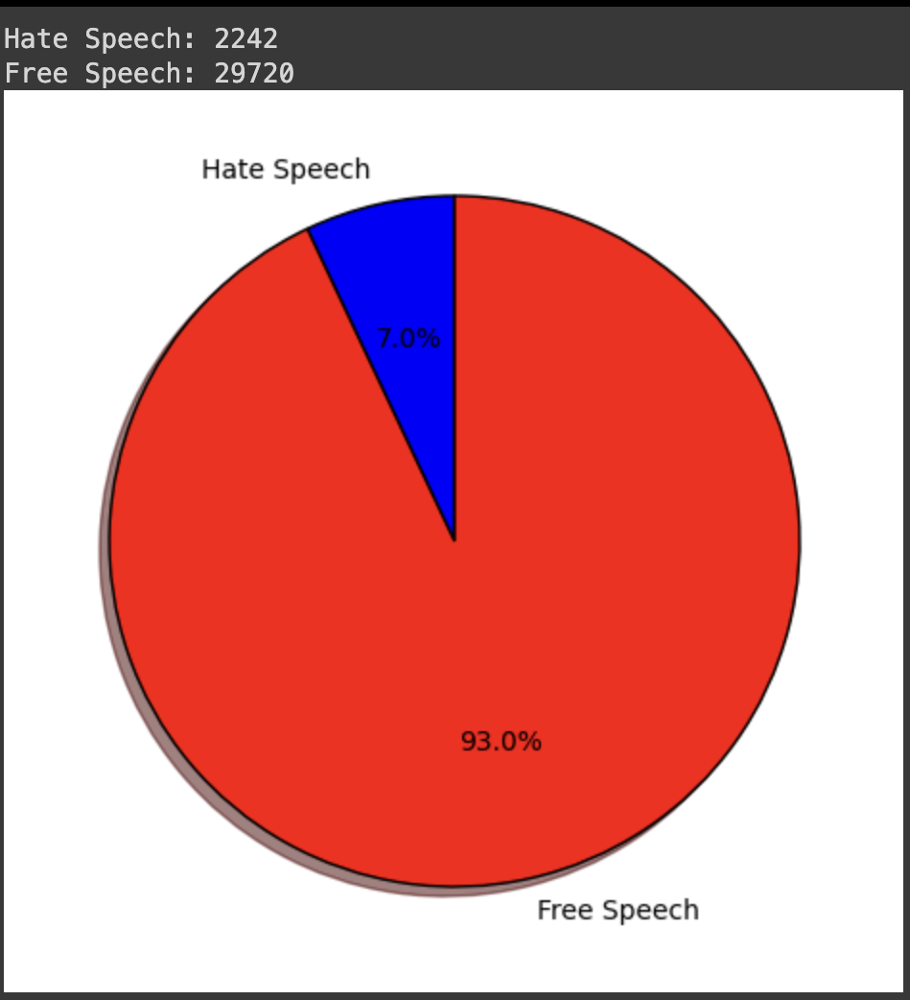
EXPLORATORY DATA ANALYSIS
The figure shows the distribution of the target attribute that is if the text is hate speech or free speech

Slide 8
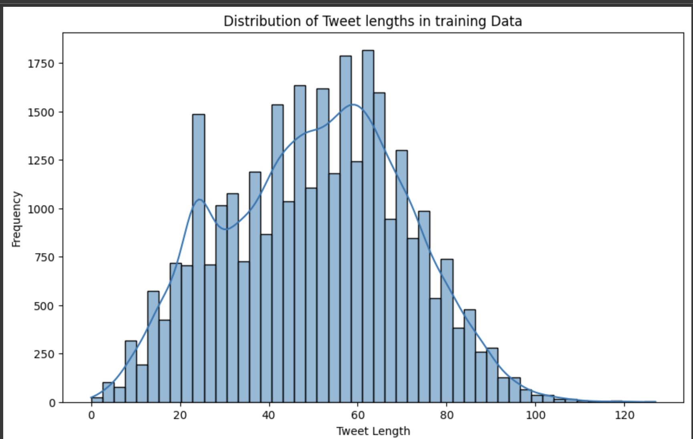
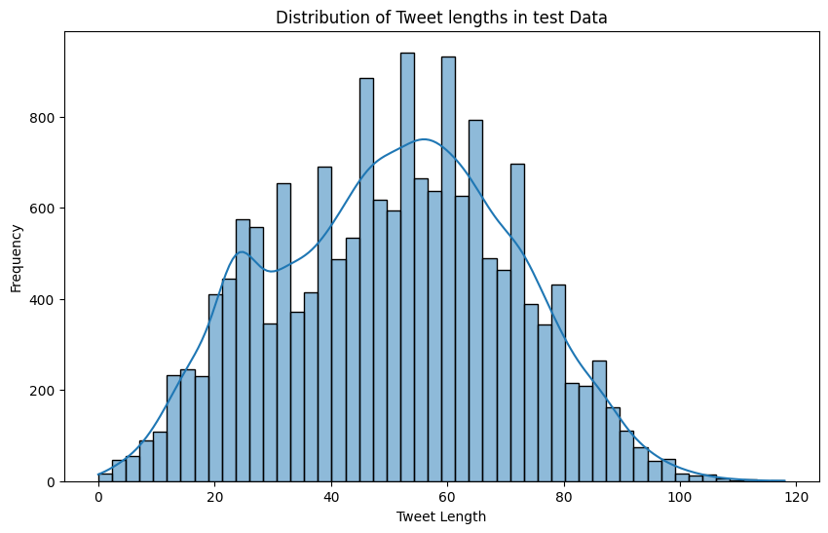
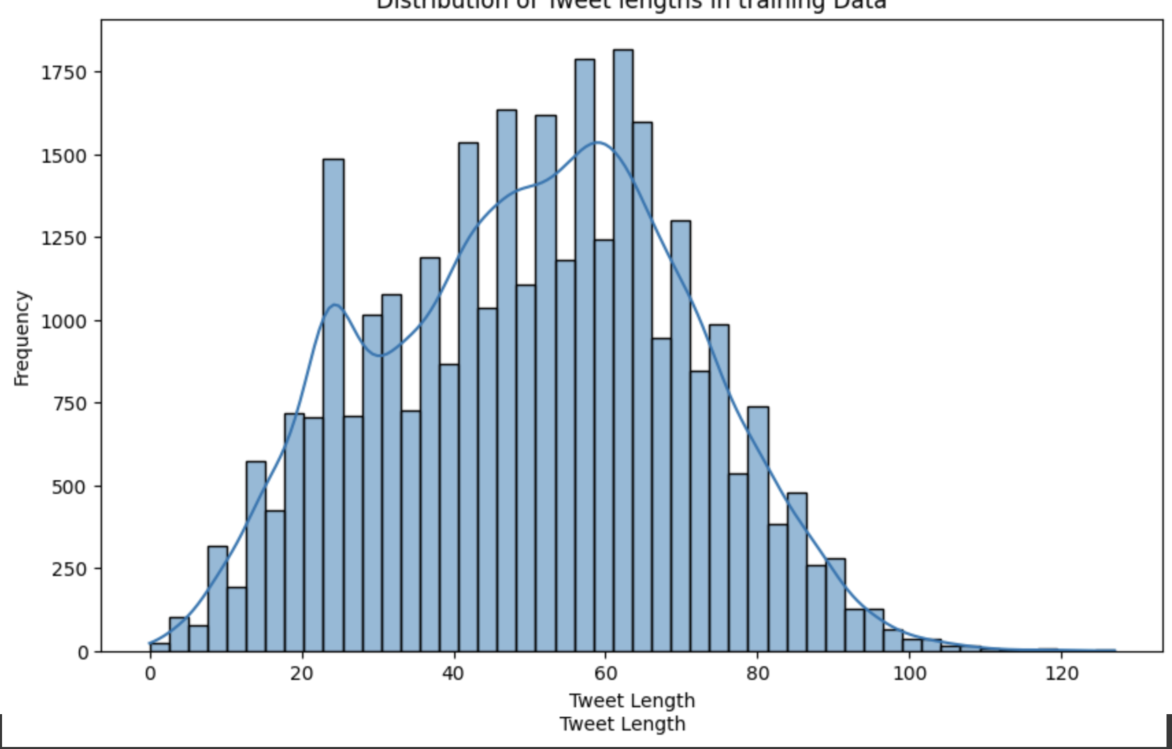
DISTRIBUTION OF TWEET LENGTHS IN TRAINING AND TEST DATA

Slide 9
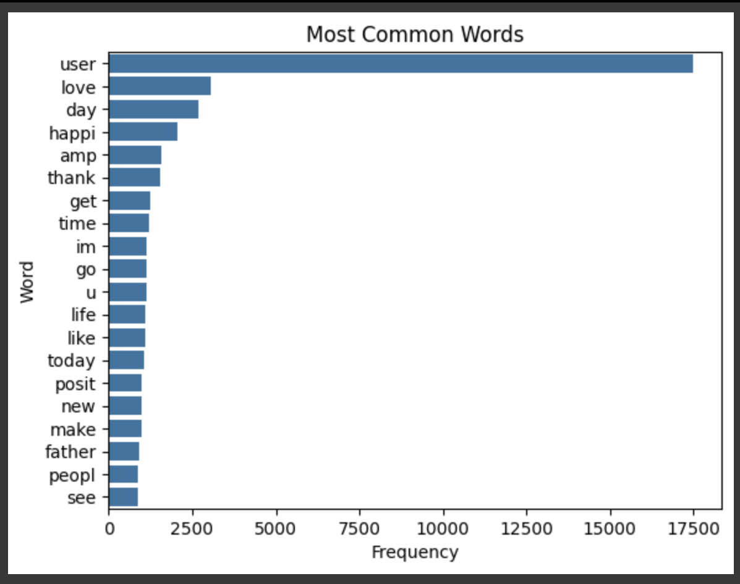
MOST COMMONG WORDS IN THE DATSET

Slide 10
Model Building
Models Used:
Logistic Regression, Random Forest, Gradient Boosting.
Transformers:
Fine-tuned BERT model for sequence classification.
Hyperparameter Tuning:
Grid search for finding optimal model parameters.

Slide 11
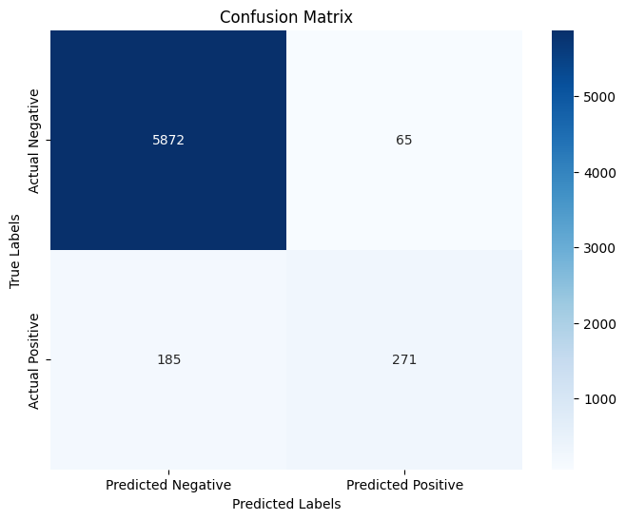
Model Evaluation(ML MODEL)
The model achieves an overall accuracy of 96%, performing well on the majority class (0) with high precision (97%) and recall (99%). However, it struggles with the minority class (1), showing lower recall (59%) and a moderate F1-score (68%), indicating it misses many positive instances despite decent precision (81%). I utilized Logistic Regression, Random Forest, and Gradient Boosting, and after performing a grid search and comparing models based on accuracy, Random Forest emerged as the best performing model with these metrics.

Slide 12
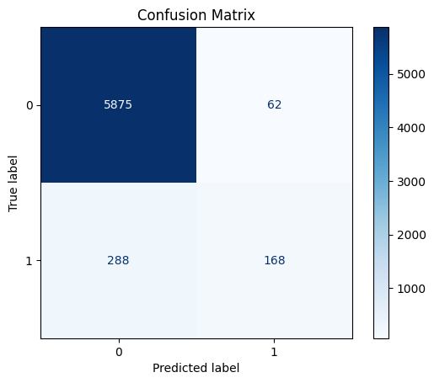
Model Evaluation(TRANSFORMERS)
The evaluation results indicate that the model has a high accuracy of 94.5% on the validation set, but the recall is relatively low at 36.8%, suggesting it misses many positive instances. The precision is 73.0%, and the F1-score, which balances precision and recall, is 48.9%, indicating a moderate overall performance.

Slide 13
Conclusion & Future Work
Summary:
Developed a model to detect hate speech with [accuracy] using various techniques.
Limitations:
Model accuracy is not perfect; some misclassifications are expected.
Future Enhancements:Implementing advanced techniques like Temporal Convolutional Networks (TCN), which capture long-term dependencies in time-series data, and Random Multimodal Deep Learning (RMDL), which integrates multiple models to enhance robustness and accuracy in complex multimodal tasks.

